Slide 1
Bootstrap
Front-End Web Development

Slide 2
Lesson 17 Change Log FEWD 3.1 - 3.2
Below are the specific changes made in this lesson.
Returning Instructor Directions:
Click on the hyperlinks below, and it will direct you to the specific slide.
Copy the entire slide, and paste in your existing curriculum deck.
Pre-Class Materials and Preparation -
Added warmup activities to the new Codepen collection “Warmups”.
Added new CodePen — Event Delegation — to Reference Code.
Share how the lesson went through our Instructor Lesson Exit Ticket - the Curriculum Feedback form: http://ga.co/curriculum-feedback

Slide 3
Pre-Class Materials and Preparation
Review all slides, lab activities, and code-alongs.
There are prompts in the speaker notes with opportunities for instructor customization.
Materials:
Reference Code
Starter Code in CodePen
Solution Code in CodePen
Warmups in CodePen

Slide 4
Bootstrap
Overview
This lesson introduces CSS frameworks. Be sure students are comfortable with how to do these things themselves first. This is a good time for a thorough review if they don't.
Learning Objectives
In this lesson, students will:
Use the Bootstrap CSS library to leverage pre-styled components.
Adapt Bootstrap components for specific use cases.
Evaluate CSS frameworks against self-written CSS.
Duration: 180 minutes

Slide 5
Suggested Agenda
Time | Activity | Purpose
0:00–0:30 | CSS Frameworks, Bootstrap Grid | Discuss the concept of CSS frameworks and place bootstrap in context. Demo the use of Bootstrap for grid purposes.
0:30–1:15 | Recreate Bootstrap Layouts | Apply bootstrap knowledge by recreating layouts.
1:15–1:45 | Bootstrap Components and Styles | Tap into the pre-built bootstrap components and styles for a consistent and familiar look.
1:45–3:00 | Recreate a Bootstrap Site | Discover how common bootstrap conventions are and use them to imitate a professional site.

Slide 6
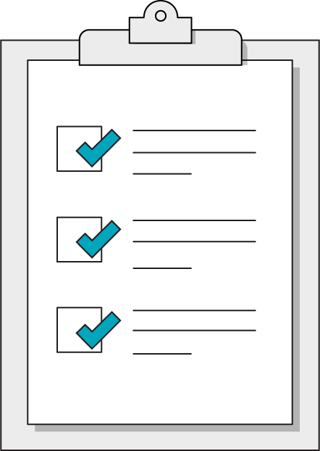
Today’s Learning Objectives
In this lesson, you will:
Use the Bootstrap CSS library to leverage pre-styled components.
Adapt Bootstrap components for specific use cases.
Evaluate CSS frameworks against self-written CSS.
‹#› | © 2020 General Assembly
Notes:
DURATION: 1 minute
TEACHING TIPS:
Learning objectives help frame the lesson and give students an idea of what to expect.
Explain to students how this lesson fits into the overall course to help them make connections with content from other lessons.

Slide 7
CSS Frameworks
Front-End Web Development

Slide 8
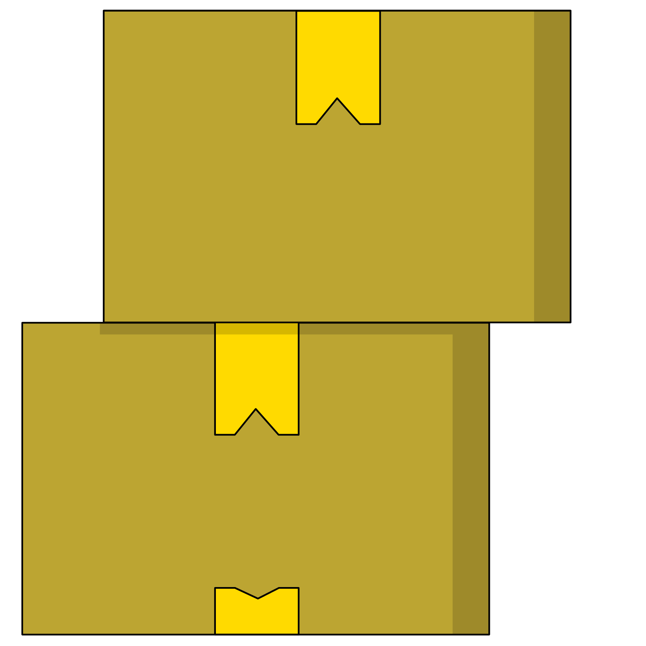
Frameworks
Frameworks are sets of pre-made HTML/CSS/JS components packaged together.
Think of a framework as a bunch of plugins made by the same team that so they work nicely together out of the box.

Slide 9

Should I Use a CSS Framework Like Bootstrap?
Benefits
Drawbacks
Gives you lots of code.
Grid-based design out of the box.
Easy integration of JS components.
Familiar, standard design feel.
Gives you lots of code.
Bloats your site with features you likely won’t use.
Design monotony.
Notes:
TEACHING TIPS:
Feel free to add your own opinions to either side of the table in your copy of this deck!

Slide 10
Framework != Instant Boost
"Oh man, I'm getting all this code for free, so I don't have to spend as much time learning how to do things."
— Dangerous Developer Thoughts, Volume XVII
Frameworks will slow you down until you learn how to use them.
When you choose to use a framework, you’re embracing patterns created by other developers. It takes time to learn these patterns.

Slide 11

Common Frameworks
Bootstrap: http://getbootstrap.com/
Foundation: http://foundation.zurb.com/
Material Design Lite: https://getmdl.io/

Slide 12
Using Bootstrap
Front-End Web Development

Slide 13

Bootstrap
The most popular framework.
Standard-feeling style
Responsive grid system.
Easy, built-in breakpoints
Plug-and-play components.
Navbars, modals, carousels...

Slide 14
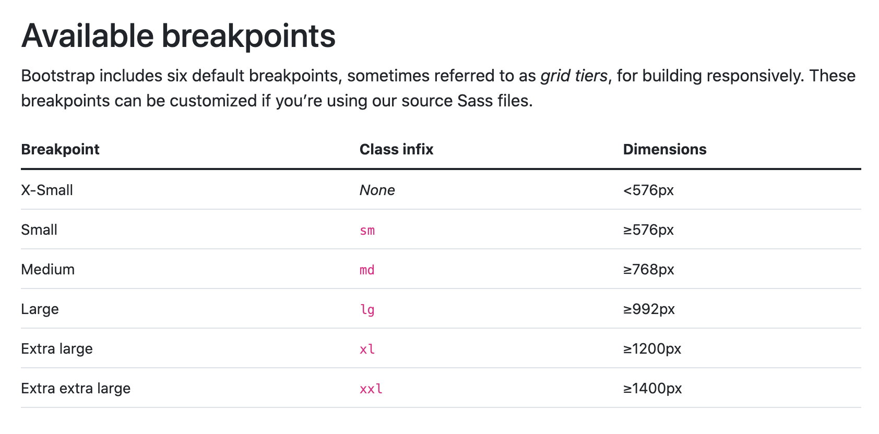

Slide 15
Grid-Based Design
Bootstrap sets up a series of 12 columns that automatically respond to screen size.
1
2
3
4
5
6
7
8
9
10
11
12

Slide 16
Bootstrap Grid
Each time you use the “row” class on a container, that container is divided into 12 default columns
You can then create child containers that “clip” into the grid and take up 1–12 columns.
1
2
3
4
5
6
7
8
9
10
11
12

Slide 17
Bootstrap Grid
All content should be placed within grid columns. Build column classes using the following formula:
col-{screen-size}-{width}
Examples of Bootstrap column classes:
<div class="col-md-6"> | A div for medium-sized screens that is 6 columns wide.
<div class="col-lg-2"> | A div for large screens that is 2 columns wide.
1
2
3
4
5
6
7
8
9
10
11
12

Slide 18
Bootstrap Grid
The grid structure is very similar to patterns in flexbox and grid:
<div class="container"> | Top-level element; holds rows
<div class="row"> | Horizontal row holds col elements. Must be the immediate child of a container.
<div class="col"> | Used to hold content & components (text/images/etc.). Must be the immediate child of a row.

Slide 19
Bootstrap Rules of the Grid
Columns must be placed into an element with the row class to create horizontal groups.
The total column width classes in a row must add up to 12.
If you don’t define specific numbers “col-md-4”, Bootstrap will divide the space equally among the number of columns
rows must be placed within a parent with the class of:
.container (fixed-width with side margins all screens) or
.container-fluid (full-width on all screens)

Slide 20
All Together Now!
This is how you Bootstrap:
<div class="container">
<div class="row">
<div class="col-6">
Your content here.
</div>
<div class="col-6">
Your content here.
</div>
</div>
</div>
1
2
3
4
5
6
7
8
9
10
11
12

Slide 21
How Would We Make This Layout?
1
2
3
4
5
6
7
8
9
10
11
12

Slide 22
Grid Layouts
45 minutes
Recreate the grid layouts displayed in this document:
https://ga-instruction.s3.amazonaws.com/assets/front-end-web-development/fewd-bootstrap/layouts.pdf

Slide 23
Bootstrap Components
Front-End Web Development

Slide 24

Components Made Easy
Bootstrap has a solid set of standard components that can easily be dropped into your site:
Navigation bars
Modals
Image carousels
Dropdown menus
And so much more!
Notes:
Source: https://getbootstrap.com/docs/4.4/components/alerts/
TEACHING TIPS:
You can scroll through the list here. Advise students to feel free to take directly from their examples, as Bootstrap documentation is more useful to new programmers as, “Here’s an example to grab and change what you’ve got to” than “Here’s explanations of all these classes you should memorize and be able to use independently!”

Slide 25
Bootstrap Nav
You’ve definitely seen the Bootstrap navbar before!
<nav class="navbar navbar-default" role="navigation">
<div class="container">
...
</div>
</nav>

Slide 26
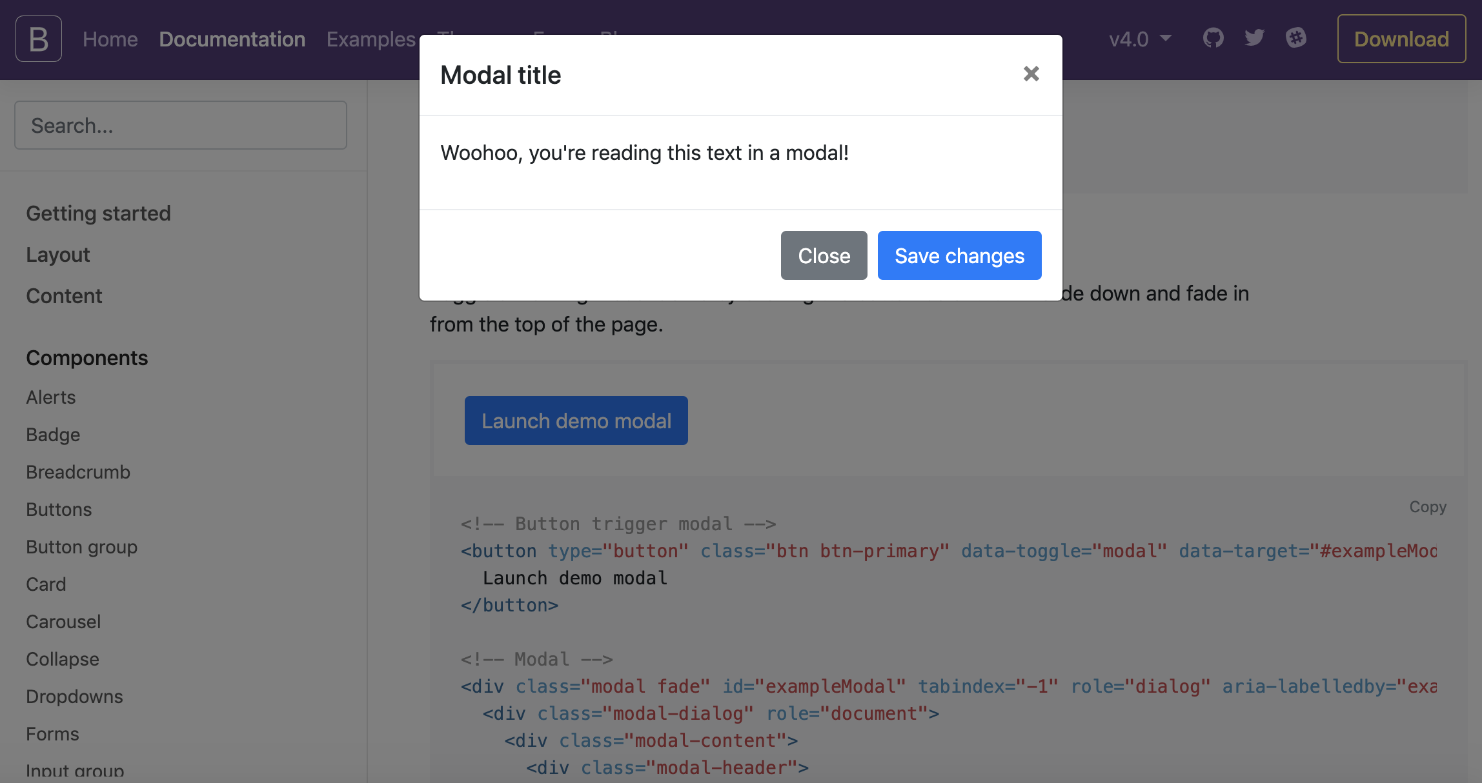
Modals: Pop Ups for Good, not Spam!
Modals allow content to be focused in a pop-up window on top of other content.
They can be toggled with JavaScript in reaction to any event, typically responding to button clicks.

Slide 27
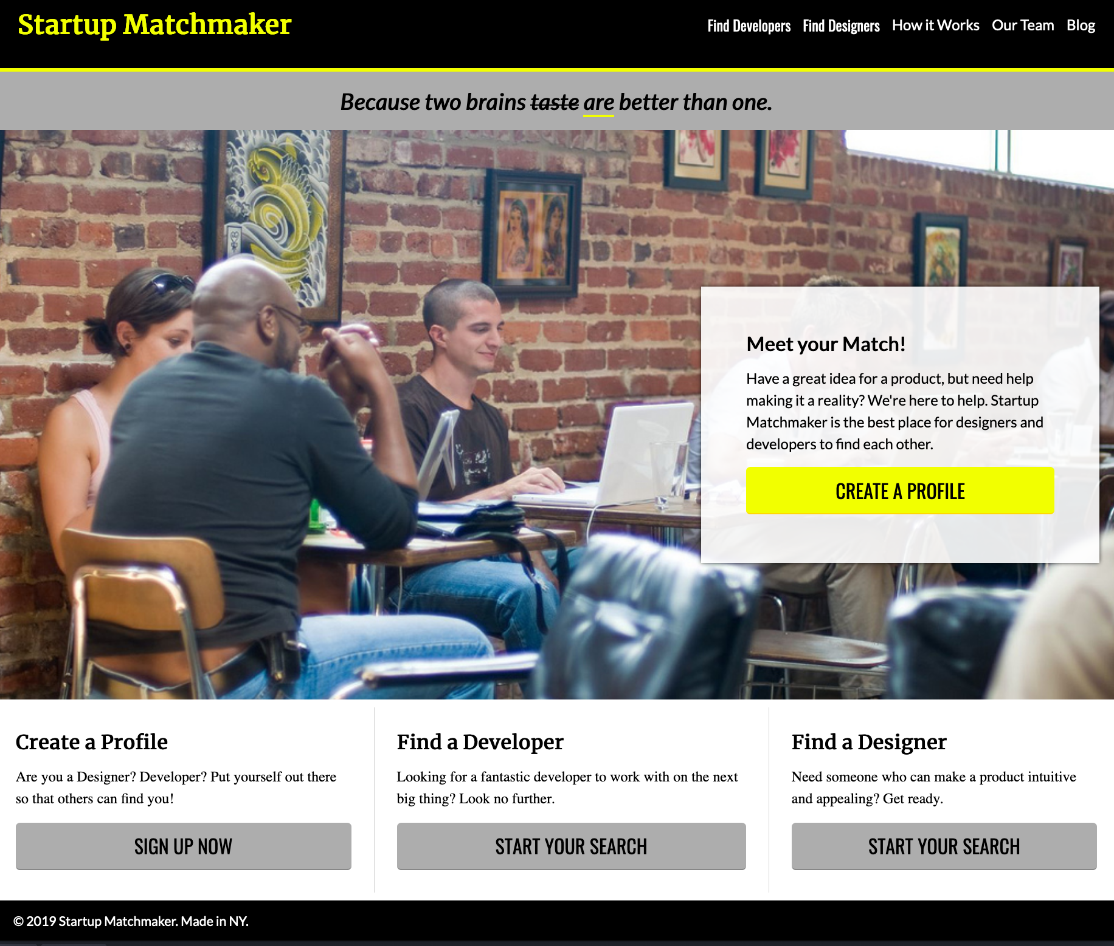
StartUp Matchmaker Bootstrapped
Reference code:
https://drive.google.com/drive/folders/1nGs9ISklpozgATRGRPEQ3e1qeldbVk35?usp=sharing
Spice up an old favorite with a new layout treatment.
Notes:
TEACHING TIPS:
Note the different breakpoints as defined in this CodePen.
Use CodePen’s full-screen view to show how the columns start stacking at different times, otherwise CodePen has its own breakpoint between the code and webpage that will mess with this!

Slide 28
Components in Action
This CodePen uses a navbar, carousel, cards, and modals to create a standard layout on the home page.
Reference code:
https://codepen.io/GAmarketing/pen/OJPoEBR

Slide 29
Styles
Front-End Web Development
(Without the Pain and Suffering of Tweaking It Yourself)

Slide 30
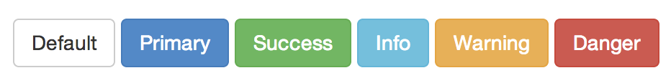
Buttons
http://getbootstrap.com/css/#buttons
<!-- Standard button --> <button type="button" class="btn btn-default">Default</button>
We can change button color and size very easily. Follow that link to see how.

Slide 31

Responsive Images
Creating responsive images is as easy as adding this class to your image: .img-responsive
This class gives us the following code: max-width: 100%; height: auto;
Notes:
TALKING POINTS:
What do those styles do for us?

Slide 32
Stylized Images
Check out these puppies:
<img src="puppy.jpg" class="img-rounded" alt="Rounded Puppy">
<img src="puppy.jpg" class="img-circle" alt="Circle Puppy">
<img src="puppy.jpg" class="img-thumbnail" alt="Puppy Thumbnail">
img-rounded creates rounded rectangles.
img-circle turns images into circles.
img-thumbnail puts a nice border around images.

Slide 33

Recreate a Bootstrap Site
Identify a site using Bootstrap and attempt to recreate it. There are many resources that list sites that use Bootstrap, or you can check your favorite sites for Bootstrap-style layouts and components.
https://expo.getbootstrap.com/

Slide 34
Key Takeaways
For Next Time
CSS Frameworks Are a Trade-Off
Developer Tools
You get pre-built style and components in exchange for learning and using their exact patterns.
Frameworks can add unnecessary bloat to a site.
The command line provides a direct interface with more powerful control over your computer.
Git and GitHub are industry-standard tools for version control.
‹#› | © 2020 General Assembly

